Slide 1
Meet the teacher
Hedgehog Class
Mrs Turner and Mrs Durrant

Slide 2
Our class
Mrs Durrant Mrs Turner Mrs Pounder Mrs Clements Mr Rice
Tues Mon morning
Wed, Thurs and Fri Mon Tues Weds Thurs and Fri Monday- Friday
Miss Rose
Mon- Thurs

Slide 3
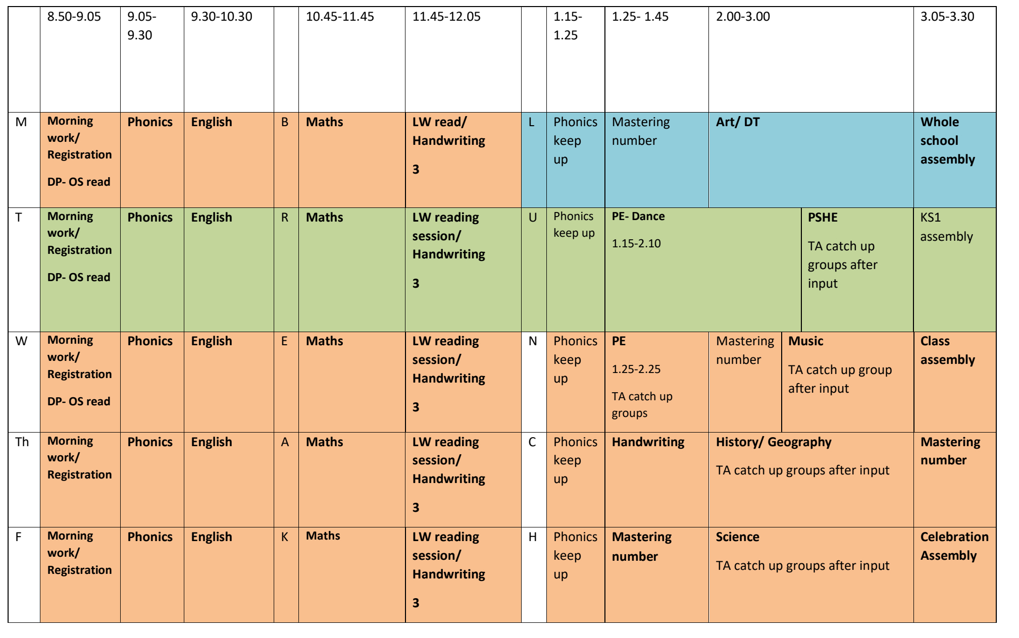
routines

Slide 4
routines
PE- Tuesday and Wednesday, please come in PE clothes.
Book changes on Friday. We will read the book three times in school across the week before it is taken home. Please ensure books are in bags every day.
Outside shoes are important as weather worsens.

Slide 5
Uniforms
Jewellery: Earrings are not allowed, except for children with pierced ears, who may
wear small, plain studs on those days when they do not have swimming or PE. It is
not sufficient to put masking tape over earrings. All other jewellery should not be
worn in school.
• Make-up: Pupils are not permitted to wear make-up in school, including nail varnish
and temporary tattoos (including henna tattoos). Any pupil wearing make-up will be
asked to remove it by the following day; should pupils fail to do so, the school
reserves the right to provide the pupil with cotton wool pads, nail varnish remover
etc. and ask the pupil to remove the make-up in school.
• Pupils in Years 1 to 6 may bring a change of footwear if they wish to go on the field
at break and lunchtimes when it is wet or muddy (e.g. wellies, trainers which are
different to those worn for indoor PE) but these must not be worn all day

Slide 6
Pe kit
Plain black/grey/dark green leggings or jogging bottoms may be worn for outdoor PE lessons when it is cold, along with a school sweatshirt/cardigan/fleece/PE hoodie (embroidered with the school logo).
Pupils should wear their PE kit to school and remain in it for the whole day on days when they have PE, including outdoor PE wear for breaks and lunchtimes when it is cold, even if the PE lesson itself is indoors
Earrings must not be worn for PE lessons and cannot be covered with tape (earrings should not be worn at all on days when your child has swimming or PE)

Slide 7
curriculum
We are teaching the full National Curriculum.
English and maths is taught every day
Science is taught weekly
PE (Physical Education) is taught twice per week, as well as other activities such as the Daily Mile and half termly ‘Commando Joe’ days.
Subjects such as history, geography, computing, PSHE, RE , art, DT and music are taught weekly or in blocks.

Slide 8
expectations
We are currently working towards the Year 1 end of year expectations. Our planning and teaching is adapted to ensure all children have the opportunity to work at the level appropriate to their needs- whether this is consolidating Year 1 work or being pushed beyond the Year 1 expectations.

Slide 9
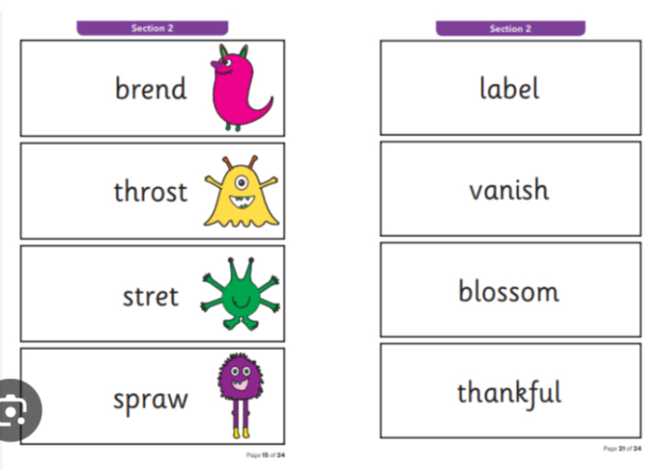
assessments
Government tests:
Phonics screening checks in June
We will provide more information about this nearer the time.
Throughout the year both informal and formal testing in school will help us to identify where children need support and to be pushed further.

Slide 10
homework
All pupils must read a book at least three times per week and record this in their planner
Every child who reads five times in a week receives a Reading Champion certificate/sticker
Every time a child receives ten Reading Champion certificates, they choose a book to keep
Online homework: Children will be expected to practice TTRS after half term and phase 5 phonics at least once weekly.

Slide 11
Homework
Your child will receive homework on Friday which will practise the tricky words we have been learning during our phonics lessons that week. It is important for the children to be able to read and spell these words.
Reading- at least 3x per week the more the better!

Slide 12
Contact us
Please do speak to us on the gate if we are available and it’s appropriate
For a longer/confidential discussion, please ask for a telephone appointment
You can also speak to a member of office staff or the Senior Leadership Team if you need further assistance
If your child is going home with someone else at the end of the day please let us know. Alternatively if you have a regular arrangement with please write this in their planner.

Slide 13
questions
Any questions?

Slide 14
Thank you

