Slide 1

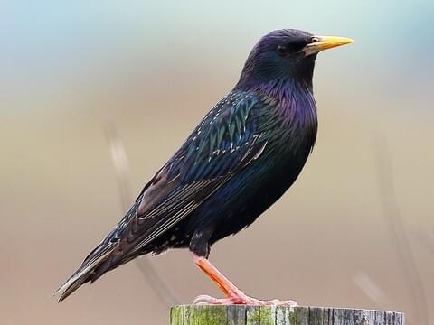
Meet the teacher
Mr Knapp – Starling class

Slide 2
Staffing
Mr Knapp – All mornings and Monday and Tuesday afternoon
Mrs Dalton – Wednesday, Thursday and Friday afternoons
Ms Litwin (Teacher Assistant) every morning in the week and Wednesday and Thursday afternoons.
Mrs McKay – Student teacher till Christmas

Slide 3
routines
Monday | Mr Knapp teaching
Tuesday | Mr Knapp teaching
Wednesday | Mrs Dalton teaching in afternoon
Thursday | Swimming in the morning and Mrs Dalton teaching in afternoon
Friday | Mrs Dalton teaching in afternoon

Slide 4
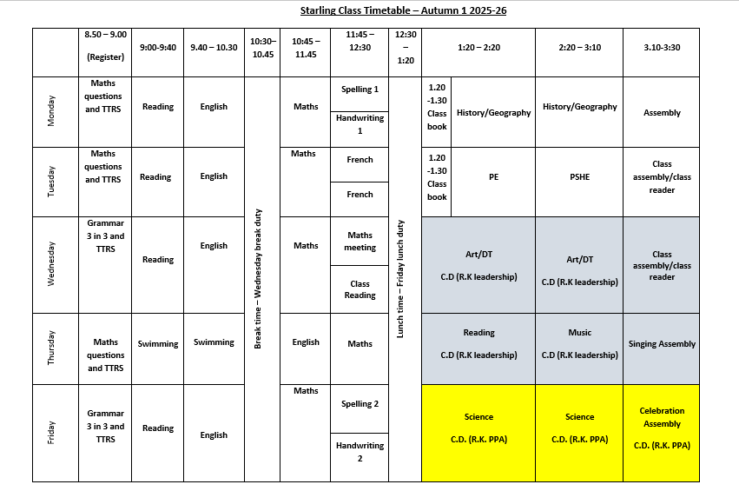

Slide 5
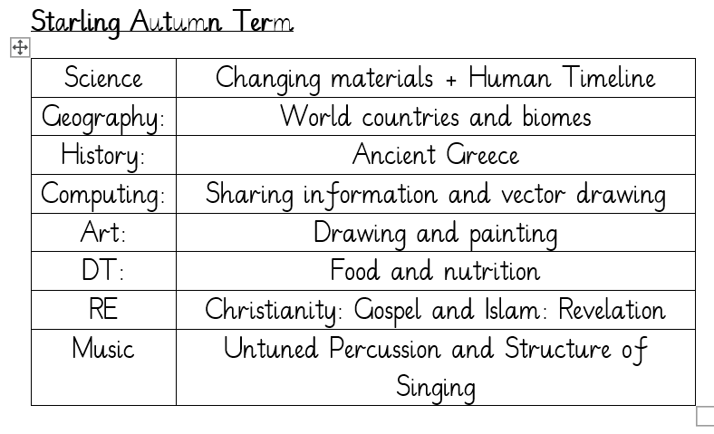
routines
Magpie Class Subjects Autumn Term

Slide 6
uniform
Pupils in Years 1 to 6 may bring a change of footwear if they wish to go on the field at break and lunchtimes when it is wet or muddy (e.g. wellies, trainers which are different to those worn for indoor PE) but these must not be worn all day (pupils who do not have a change of footwear will be allowed to go on the field at break and lunchtimes when it is dry; pupils who do not have the correct footwear in school will not be allowed to go on the field or sports court at break or lunchtimes).
Correct school uniform must be worn at all times. A note will be put in planners if uniforms are incomplete.

Slide 7
Pe kit
Plain black/grey/dark green leggings or jogging bottoms may be worn for outdoor PE lessons when it is cold, along with a school sweatshirt/cardigan/fleece/PE hoodie (embroidered with the school logo).
Pupils should wear their PE kit to school and remain in it for the whole day on days when they have PE, including outdoor PE wear for breaks and lunchtimes when it is cold, even if the PE lesson itself is indoors
Earrings must not be worn for PE lessons and cannot be covered with tape (earrings should not be worn at all on days when your child has PE)

Slide 8
curriculum
English and maths is taught every day
PE (Physical Education) is taught twice per week we also have the daily mile and Commando Joe’s
We are teaching Geography, History, Computing, Art, and DT weekly.
Music, RE (Religious Education), French and PSHE (Personal, Social & Health Education)will be taught weekly or in blocks depending on the half-term in question.

Slide 9
expectations
School positive relationships policy followed by all pupils at all times.
If homework is not completed it is then done in the hall on Tuesday break time.
If iPads are not charged or are left at home, after 1 warning, a break time is missed.

Slide 10
homework
All pupils must read/share a book at least three times per week and record this in their planner – they will be checked on Monday mornings.
Every child who reads five times in a week receives a Reading Champion certificate.
Every time a child receives ten Reading Champion certificates, they choose a book to keep
Weekly arithmetic homework on Showbie – only three questions
Weekly spelling homework on Showbie – one sheet per week
All homework given on a Friday and checked the following Tuesday.

Slide 11
How can you support your child?
Ensure they read regularly
Use the hints in the home school book to support your child when reading, asking comprehension questions is very important.
Help them learn their times tables through using TTRS etc
Encourage independence – they pack and carry their bag, fill their water bottle, remember their lunch box.
Teach them to tie their shoelaces.
Ask them what they enjoyed about school each day.

Slide 12
ATTENDANCE MATTERS
Our target this year is for every child to have at least 96% attendance.
This means having no more than seven days off across the whole school year!
If your child has one day off per month, their attendance would be 94%.
If they have one day off per fortnight, their attendance would be below 90%, which would be recorded by the Government as Persistent Absence.
Any child whose attendance is below 90% will be given an Attendance Plan.
As well as our usual rewards for every class whose attendance is at least 96%, we are introducing a new reward scheme for pupils, where they will get a ticket to spend in the school shop every time they are here all week – that’s a maximum of 38 tickets, which would ‘buy’ amazing prizes!
Notes:
Think of it like an arcade where the more tickets you have, the better the prize you can exchange them for. The ‘shop’ will be open at the end of each half term.

Slide 13
WHY IS ATTENDANCE SO IMPORTANT?
Every day at school counts – even a few days of missed school can have a massive effect on a child’s education and life chances.
Government research shows that primary school children who attend nearly every day are 30% more likely to reach the expected standard in reading, writing and maths than pupils who only attend 90-95% of the time.
Research also shows that pupils whose attendance is below 90% (which is the same as having one day off every two weeks) could earn £10,000 less per year as an adult than a pupil who attended school nearly every day.
We need your help to make good attendance a priority: only keep your child off school when they are genuinely too ill to attend, and talk to us if there is anything that we can do to work together.
Notes:
Think of it like an arcade where the more tickets you have, the better the prize you can exchange them for.

Slide 14
Trips
British Museum – Ancient Greece and Ancient Egypt
Under Starters Orders – Dalham Stud, Horse Racing Museum, Day at the Races
Reach for the Stars – Anglia Ruskin University
Wonder Dome – Newmarket Academy

Slide 15
Contact us
Please do speak to us on the door if we are available and it’s appropriate
Please avoid coming up the steps as it can be a bottle neck when getting the children in and out.
For a longer/confidential discussion, please ask for a telephone or face to face appointment
You can also speak to a member of office staff or the Senior Leadership Team if you need further assistance

