Slide 1

Meet the teacher
Miss Harvey

Slide 2
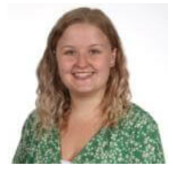

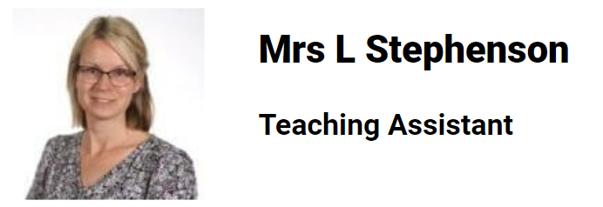
Our class
Miss Harvey
All the time except for Tuesday afternoons

Slide 3
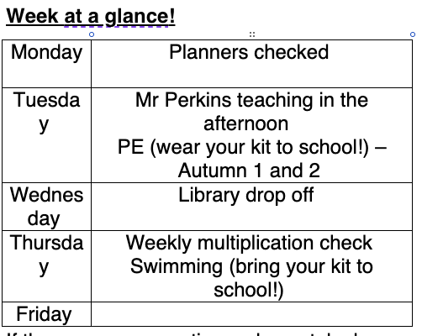
Routines

Slide 4
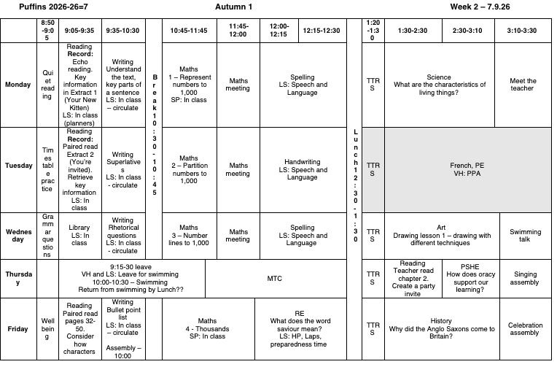
routines

Slide 5
routines
PE is on Tuesday and a Thursday. Please come in your kit. This will be the same all year.
(Swimming is Thursday)
Planners are checked on Mondays – reading logs can be completed by your child and signed by you to confirm the reading
TTRS are done every day.

Slide 6
Swimming
In Year 4, we start weekly swimming lessons. These take place throughout Year 4 and Year 5.
Our swimming lessons are always on a Thursday
If anyone is able to walk with us to and from the leisure centre every week, it would be incredibly appreciated! Please let the office know ASAP
Biscuits
Kit list:
  Wearing swimming costume underneath PE kit to school in the morning
  Towel
  Swimming hat (can be purchased from the office)
  Googles – a letter has to be supplied to wear them
  Underwear in their bag

Slide 7
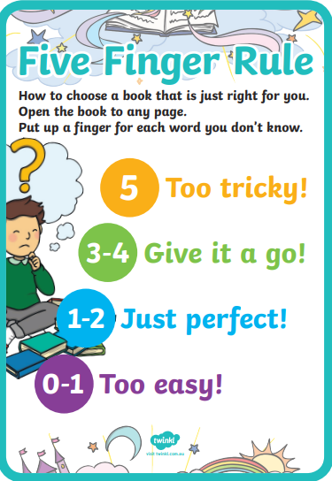
Reading
In year 4, children will be supported to choose a reading book at the appropriate level. Some children will choose a reading book from the classroom, but the majority will take them out of the library.

Slide 8
Reading
They can also take a book out of the library for free reading (either one they can read independently or one to share with parents and carers).
We encourage children to read from a wide variety of genres. Whilst we want the children to read their school book, we also encourage children to read comics, magazines, newspapers, recipes, instructions, poetry etc
If the children have read a book from home you can also add this in their planner
Reading twice in one day only counts once in the weekly challenge

Slide 9
Reading
Children are expected to read a minimum of three times a week. If they don’t read three times a week, they will be asked to spend some time at playtime reading in the hall.
If they read five times a week, they will receive a certificate sticker in their planner. When they have done this 10 times, they can choose a book to keep from a collection of new books.

Slide 10
uniform
Pupils may bring a change of footwear if they wish to go on the field at break and lunchtimes when it is wet or muddy (e.g. wellies, trainers which are different to those worn for indoor PE) but these must not be worn all day
Pupils in Years 1 to 6 may bring a change of footwear if they wish to go on the field at break and lunchtimes when it is wet or muddy (e.g. wellies, trainers which are different to those worn for indoor PE) but these must not be worn all day (pupils who do not have a change of footwear will be allowed to go on the field at break and lunchtimes when it is dry; pupils who do not have the correct footwear in school will not be allowed to go on the field or sports court at break or lunchtimes).

Slide 11
Pe kit
Plain black/grey/dark green leggings or jogging bottoms may be worn for outdoor PE lessons when it is cold, along with a school sweatshirt/cardigan/fleece/PE hoodie (embroidered with the school logo).
Pupils should wear their PE kit to school and remain in it for the whole day on days when they have PE, including outdoor PE wear for breaks and lunchtimes when it is cold, even if the PE lesson itself is indoors
Earrings must not be worn for PE lessons and cannot be covered with tape (earrings should not be worn at all on days when your child has swimming or PE)

Slide 12
curriculum
English and maths is taught every day
PE (Physical Education) is taught twice per week (Tuesday and Thursday), we also have the Laureate mile
We are teaching Geography, History, Art, and DT (Design Technology, RE (Religious Education), French and PSHE (Personal, Social & Health Education) will be taught weekly. DT and Art alternate every 3 weeks. Music and computing are taught as block days.

Slide 13
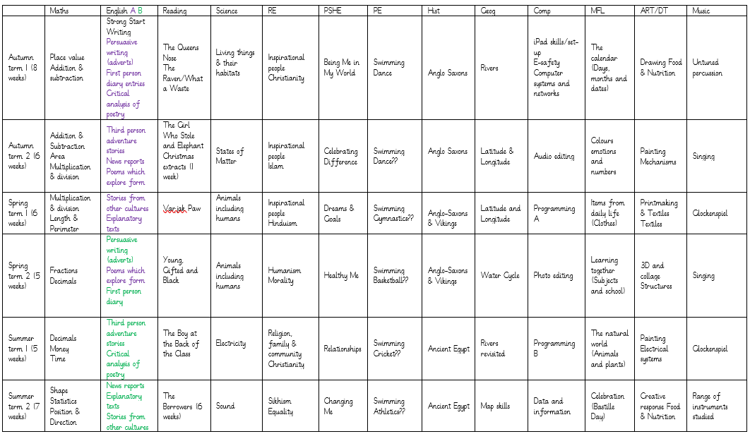
Curriculum

Slide 14
curriculum
Any concerns around PSHE curriculum then please let me know and I can provide the materials from the lessons.

Slide 15
Curriculum
iPads – sending them home
Meeting will be held on the week commencing 5th October. I will confirm the dates over the next few days and it will be sent out inviting you all to attend.
Forms will then be released and the iPads will be sent home following this at a determined date.

Slide 16
How can you support your child?
Ensure they read regularly
Use the hints in the home schoolbook to support your child when reading, asking comprehension questions is very important.
Help them learn their times tables through using TTRS etc
Encourage independence – they pack and carry their bag and swimming kit, fill their water bottle, remember their lunch box.
Teach them to tie their shoelaces.
Ask them what they enjoyed about school each day.

Slide 17
ATTENDANCE MATTERS
Our target this year is for every child to have at least 96% attendance.
This means having no more than seven days off across the whole school year!
If your child has one day off per month, their attendance would be 94%.
If they have one day off per fortnight, their attendance would be below 90%, which would be recorded by the Government as Persistent Absence.
Any child whose attendance is below 90% will be given an Attendance Plan.
As well as our usual rewards for every class whose attendance is at least 96%, we are introducing a new reward scheme for pupils, where they will get a ticket to spend in the school shop every time they are here all week – that’s a maximum of 38 tickets, which would ‘buy’ amazing prizes!
Notes:
Think of it like an arcade where the more tickets you have, the better the prize you can exchange them for. The ‘shop’ will be open at the end of each half term.

Slide 18
WHY IS ATTENDANCE SO IMPORTANT?
Every day at school counts – even a few days of missed school can have a massive effect on a child’s education and life chances.
Government research shows that primary school children who attend nearly every day are 30% more likely to reach the expected standard in reading, writing and maths than pupils who only attend 90-95% of the time.
Research also shows that pupils whose attendance is below 90% (which is the same as having one day off every two weeks) could earn £10,000 less per year as an adult than a pupil who attended school nearly every day.
We need your help to make good attendance a priority: only keep your child off school when they are genuinely too ill to attend, and talk to us if there is anything that we can do to work together.
Notes:
Think of it like an arcade where the more tickets you have, the better the prize you can exchange them for.

Slide 19
Trips
Throughout the year, we have 3 trips.
Autumn: West Stow Anglo Saxon Village – Wednesday 18th November 2026
Spring: Residential to It’s Rocket Science – Thursday 11th – Friday 12th March 2027
Summer: a train ride to Shepreth Wildlife Park
If any adults are able to support us with our trips, it would be greatly appreciated!

Slide 20
assessments
Every term we do internal school assessments to monitor how the children are progressing and what help they need. They are different this year.
This involves a maths and reading fluency check, formal papers in reading maths and then spelling assessments.
In June, we also have the Multiplication Check. This is a test of their times tables knowledge up to 12 x 12.

Slide 21
homework
All pupils must read/share a book at least three times per week and record this in their planner
Every child who reads five times in a week receives a Reading Champion certificate
Every time a child receives ten Reading Champion certificates, they choose a book to keep
We are also adding in a weekly spelling activity, this will be set on a Monday and be expected in on the following Monday
We are also asking for at least 3 times a week, practicing of TTRS to allow for the best possible outcomes later in the year.

Slide 22
questions
Any questions?

Slide 23
Contact us
Please do speak to us on the gate if we are available and it’s appropriate
For a longer/confidential discussion, please ask for a telephone or face to face appointment
You can also speak to a member of office staff or the Senior Leadership Team if you need further assistance

Slide 24
Thank you

