Slide 1

Meet the teacher
Reception – Bumblebee Class 2026-27

Slide 2
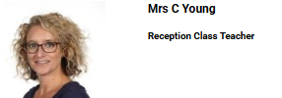
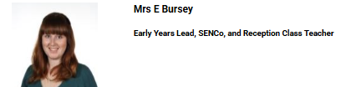
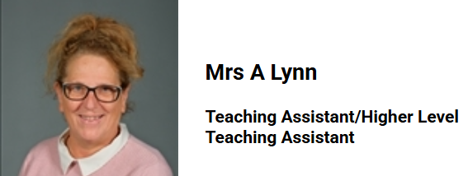
Classroom staff
Mrs Young teaches Monday-Wednesday and Mrs Bursey teaches Thursdays and Fridays.
Ms Lynn will support in class all week.
We will have other adults (teaching assistants) in the class supporting your children who you will get to know from September.

Slide 3





Our Day
We come in and register where we ask the children what they are having for lunch.
Then we do a short phonics sessions.
Next, children go to playing and learning time and have snack at 10.30am.
Then we do a Storytime and foundational knowledge session and then children go to their playing and learning and work in small groups.
Lunch is 12-12.50. Children eat in the dinner hall and when finished have a short play in our garden. After Christmas they will play on the main playground with the rest of the school.
In the afternoon we do another short phonics session and maths. Then go to playing and learning.

Slide 4



Communications
A whole school weekly newsletter is sent out via email. This has key dates and additional information on it. It is sent by email. Please check this each week.
Home school planners should be in bags every day. You can use these to write short message to us and record when your child reads at home.
You can also use Tapestry to communicate with us.

Slide 5
Tapestry
We use Tapestry to record weekly whole class observations and share special events.
We would also encourage you to share learning experiences and family times on there too.

Slide 6

Reading
We expect you to read with your child at home 5 times a week and record this in their planner. Reading at home makes a difference to your child’s progress.
They achieve a tick to acknowledge each week when they read 5 times. On their tenth week of reading 5 times, they will receive a certificate and a book to take home.
We will in time be sending home a reading book. We will let you know when we will be doing this.
We will be doing a phonics share session for you to see phonics in action in the second half of Autumn Term. We will send out advance warning of this via a letter.

Slide 7
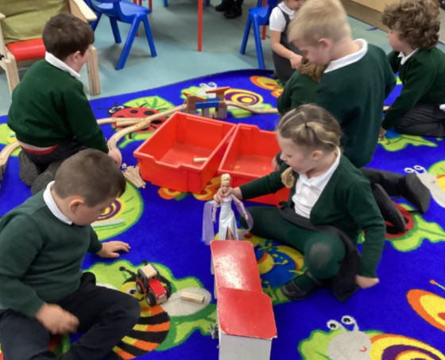
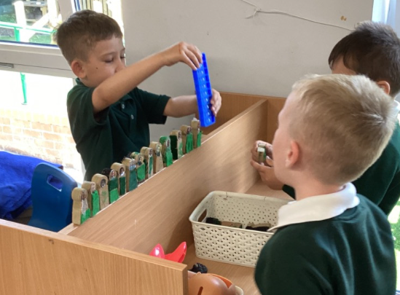
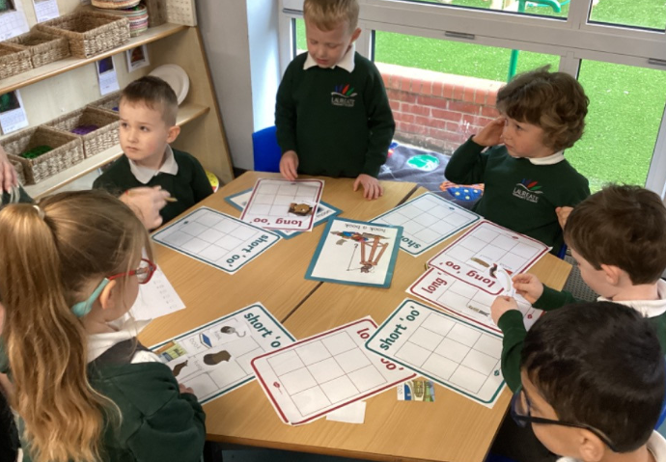
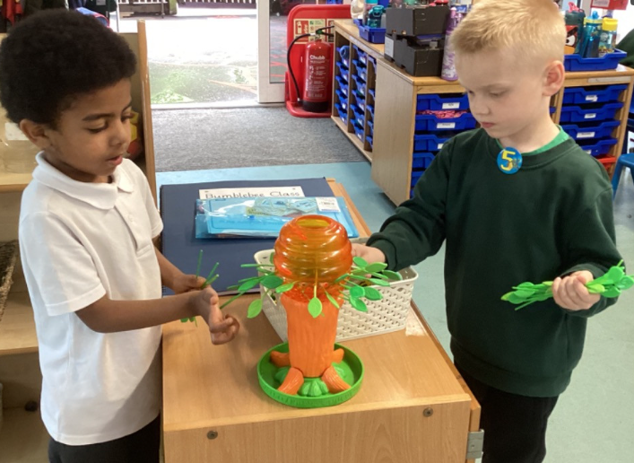
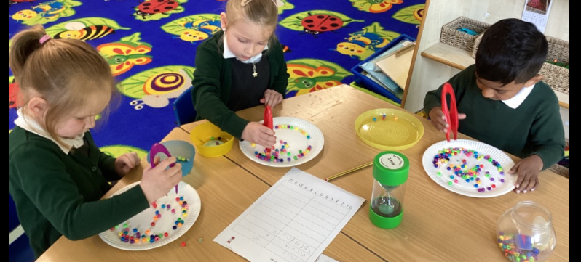
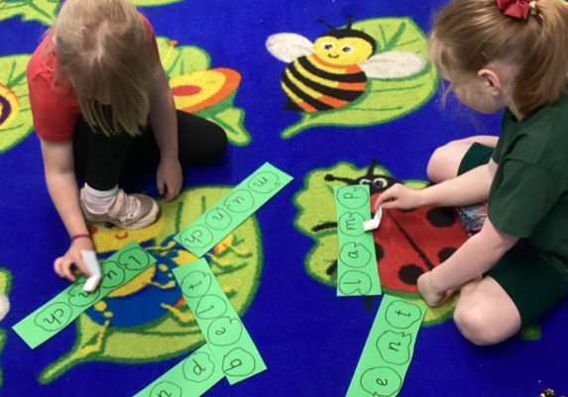
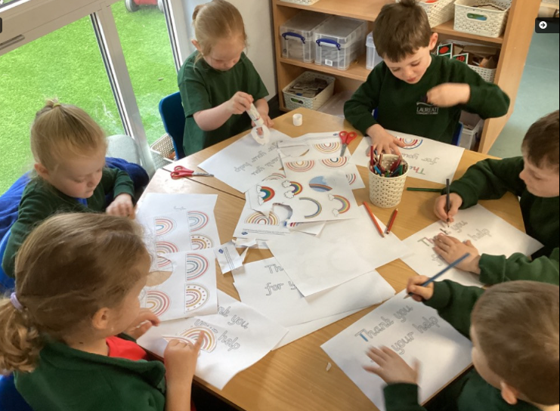
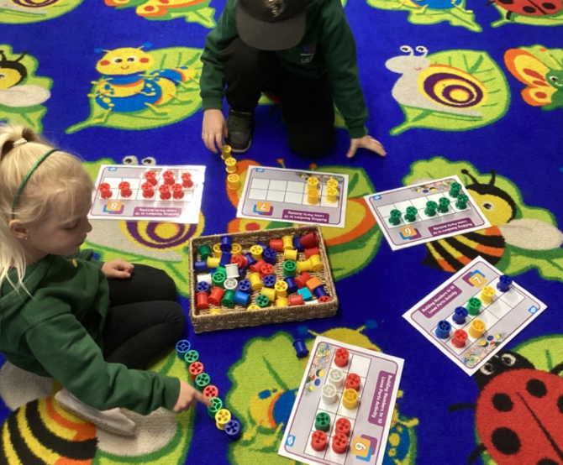
Learning in our classroom

Slide 8
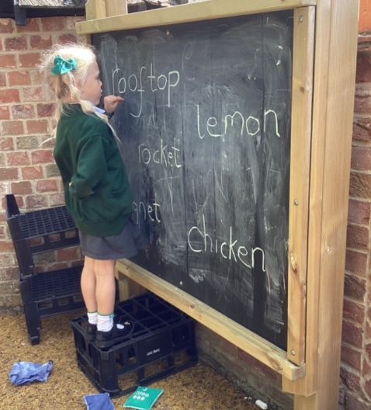
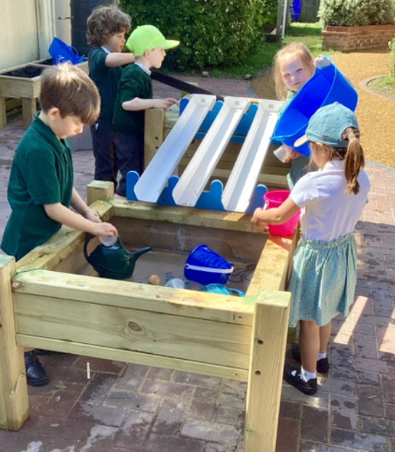
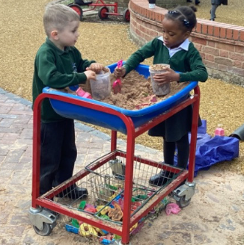
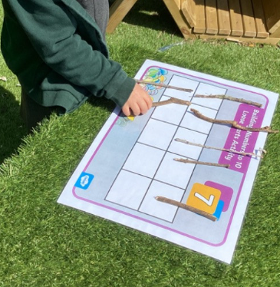
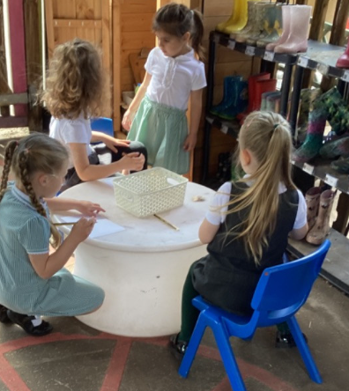
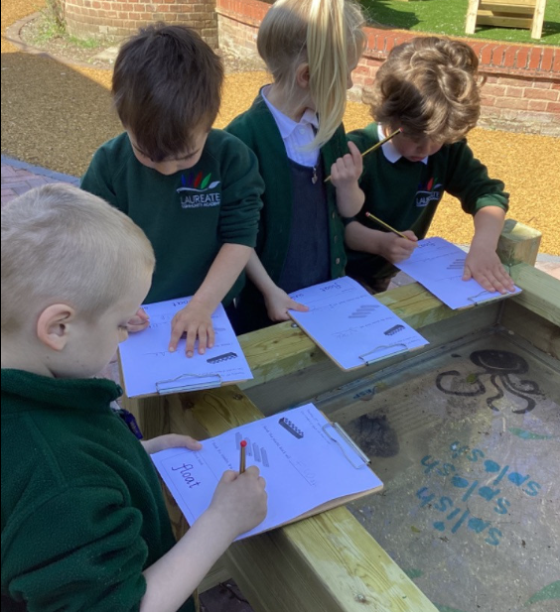
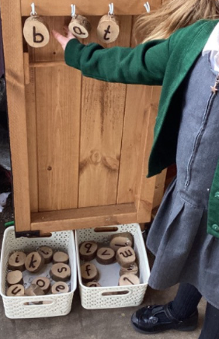
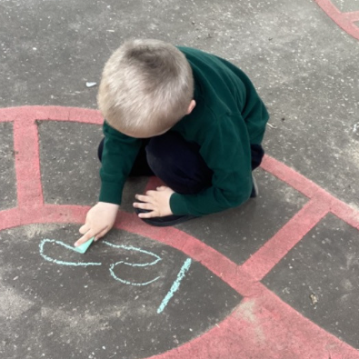
Outdoor learning

Slide 9


Uniform
It is expected that all children will wear school uniform and school shoes. No trainers or sandals.
On PE days children are asked to wear PE kit and their house colour t-shirt. Our PE day is a Tuesday. PE days can change each half term/term but we will let you know if it changes.
Earrings are not to be worn on PE days for health and safety reasons. We do not put tape on earrings so they must be removed before school.
All this can be seen in more detail on our school website under the uniform policy.

Slide 10
Assessments
In reception there is a Government assessment called the Baseline assessment. This is completed with children in their first few weeks in school and is reported back to the government. We also do our own assessment son the children in maths, writing and reading skills.
These assessments are to get a rough idea of where your child is working with their basic maths and English skills.
We also monitor children’s progress and attainment at regular points throughout the year.
Parents evenings happen each term and are a chance to discuss your child’s progress and attainment, as well as their general wellbeing in school.

Slide 11
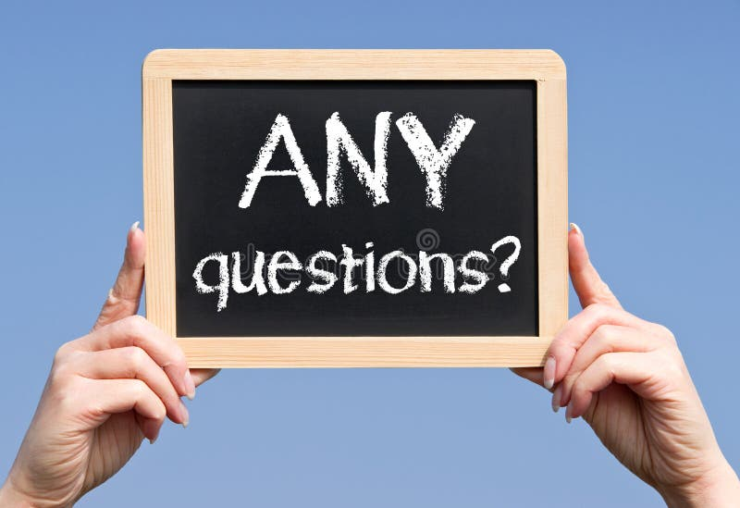
Thank you!

