Slide 1

Meet the teacher
Rabbit Class
Miss Noe

Slide 2
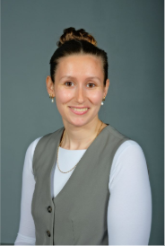
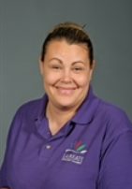
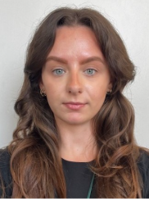
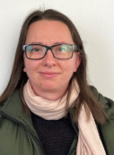
Our class
Miss Noe
Monday-Friday
Mrs Yates
Monday-Friday
Miss Sarah
Monday- Friday PM
Mrs Whitton
Monday- Friday AM

Slide 3
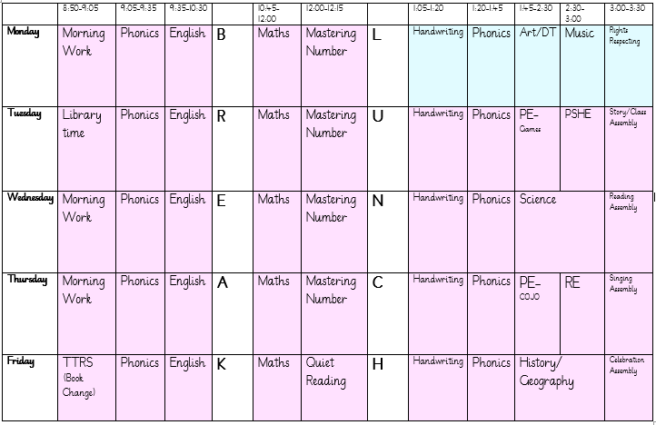
routines
Miss Noe teaching
Mrs Marshall teaching

Slide 4
routines
PE- Tuesday and Thursday, please come in PE clothes, hair must be tied up and earrings out. All other week days children come to school in their normal uniform. See Uniform policy for further guidance.
Book changes on Friday. Children will read their book multiple times in school as well as at home. Please ensure books and planners are in bags every day.
For safety reasons, we expect all children with long hair (below the shoulder line) to have their hair tied back at all times.
Outside shoes are important as weather worsens.

Slide 5
Pe kit
Plain black/grey/dark green leggings or jogging bottoms may be worn for outdoor PE lessons when it is cold, along with a school sweatshirt/cardigan/fleece/PE hoodie (embroidered with the school logo).
Pupils should wear their PE kit to school and remain in it for the whole day on days when they have PE, including outdoor PE wear for breaks and lunchtimes when it is cold, even if the PE lesson itself is indoors
Bare feet, plimsolls or clean trainers (different to those worn for outdoor PE lessons) for indoor PE lessons.
Earrings must not be worn for PE lessons and cannot be covered with tape (earrings should not be worn at all on days when your child has swimming or PE)

Slide 6
Reading Books and Planners
Children need to bring their planner and reading book to school everyday.
Planners are checked and books are changed on a Friday.
To receive a reading champion sticker your child needs to read at home 5 times in a week and it must be recorded in their planner. Once they have done this 10 times they get a certificate and a book to keep.
Once a planner has been checked we will not go back and amend weekly reads/reading champion stickers.
If a book comes back to school damaged you may be asked to contribute towards a replacement (£2.50)

Slide 7
curriculum
We are teaching the full National Curriculum.
English and maths is taught every day
Science is taught weekly
PE (Physical Education) is taught twice per week, as well as other activities such as the Daily Mile.
Subjects such as history, geography, computing, PSHE, RE , art, DT and music are taught weekly or in blocks.

Slide 8
expectations
We are currently working towards the Year 2 end of year expectations. Our planning and teaching is adapted to ensure all children have the opportunity to work at the level appropriate to their needs- whether this is consolidating Year 1 work or being pushed beyond the Year 2 expectations.

Slide 9
expectations
Reading
• Read with fluency and expression
• Comment on plot, setting and characters in familiar and unfamiliar stories
• Ask and answer simple questions, and begin to make inferences and predictions
Be secure at Phase 6 Phonics
• Read and spell common exception words

Slide 10
expectations
Writing
Write different kinds of sentence: statement, question, exclamation and command
Use expanded noun phrases to add descript-tion and specification (for example the blue butterfly)
Join sentences using conjunctions(when, if, that, because, and, but)
Correct and consistent use of present tense and past tense
Correct and consistent use of a wider range of punctuation: capital letters, full stops, questions marks, exclamation marks and commas in a list
Be able to use an apostrophe for omission of letters (wasn’t, can’t)
Begin to join handwriting
Spelling
Spell common exception words (see list)
Add suffixes to spell longer words including –ment, –ness, –ful, –less, –ly

Slide 11
expectations
Maths
Compare and order numbers up to 100.
• Read and write all numbers to 100 in digits and words
• Recall and use +/- facts to 20
• Derive and use related facts to 100
• Count in multiples of 2, 3, 5 and 10 from any number up to 100
• Recall and use multiplication and division facts for 2, 5 and 10 tables to solve x and ÷ equations
• Recognise place value of any 2-digit number
• Add and subtract:
2-digit and 1-digit (43+6)
2-digit and 10s (45-20)
Two 2-digits(13+34)
Three 1-digit (4+5+7)
• Recognise and use inverse (14+5=19, so 19-5=14, 3x5=15, so 15 ÷ 3=5)
• Recognise, find, name and write 1/3; 1/4; 2/4; 3/4
• Recognise equivalence of simple fractions (2/4 =½)
• Use symbols for £ and p and add/subtract amounts of money
• Know and use standard measures, e.g. cm and g
• Tell time to five minutes, including quarter past/to
• Describe properties of 2D shape including the number of sides and lines of symmetry

Slide 12
assessments
Government tests:
Phonics screening checks.
We will provide more information about this nearer the time.
Throughout the year both informal and formal testing in school will help us to identify where children need support and to be pushed further.

Slide 13
homework
All pupils must read a book at least three times per week and record this in their planner.
Every child who reads five times in a week at home receives a Reading Champion certificate/sticker.
Every time a child receives ten Reading Champion certificates, they choose a book to keep
Online homework: Children will be expected to practice TTRS after half term and phonics at least once weekly.

Slide 14
Contact us
Please do speak to me on the gate if I am available and it’s appropriate
For a longer/confidential discussion, please ask for a telephone appointment
You can also speak to a member of office staff or the Senior Leadership Team if you need further assistance
If your child is going home with someone else at the end of the day please let us know. Alternatively if you have a regular arrangement with a trusted adult already please write this in their planner.
If you need to contact me via email please email admin and this will be forwarded onto myself.

Slide 15
questions
Any questions?

Slide 16
Thank you

